Slide 1
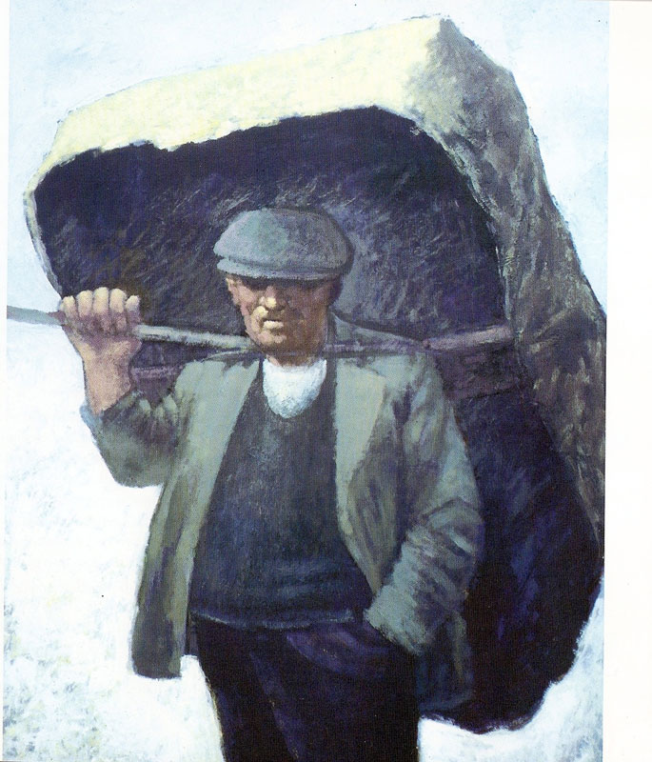
Used with kind permission of Aneurin Jones
A series of interactive lessons and instructions for teachers to create a art project:
Years 5 a 6
Lesson 8
Workers and the workhouse during Victorian Times
Next page
Notes:
1

Slide 2
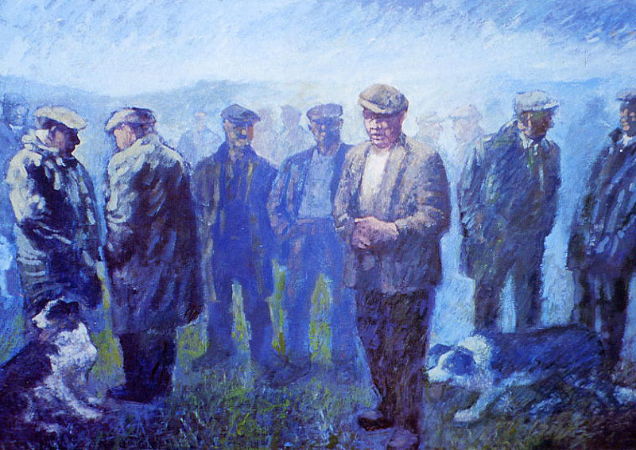
You are learning to observe and discuss a series of pictures that show life of workers during Victorian Times.
We will look at work by the Welsh artists Aneurin Jones and Nicholas Evans.
We will discuss what we see in the pictures, by noting the emotions and poses/gestures shown.
We will try to discover how the colours and tones used are able to convey life during this period of time.
Previous page
Next page

Slide 3
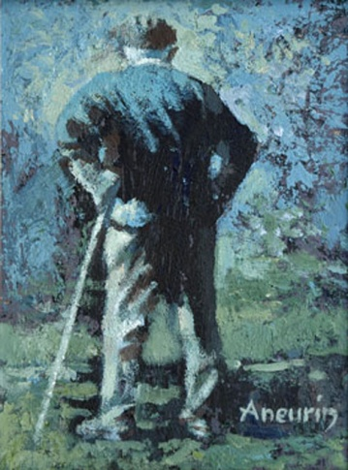
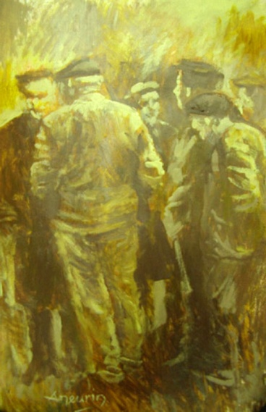
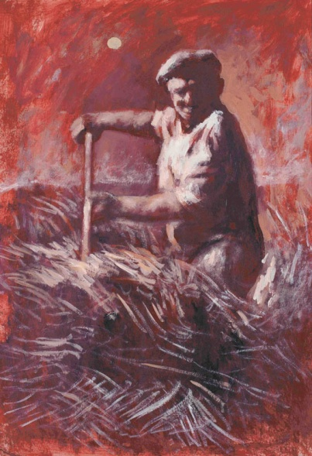
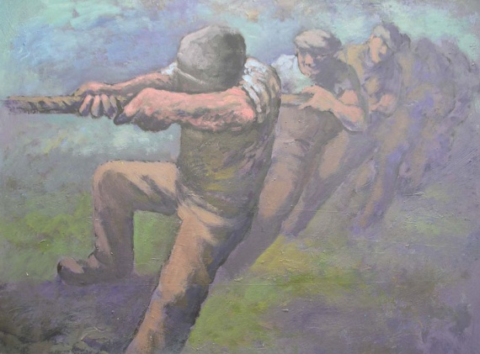
Click on the picture to enlarge.
Aneurin Jones Pictures
Used with kind permission of Aneurin Jones
Sir Gar
Cwm Wysg
Cymeriadau,
Nicholas Evans Pictures
Lleuad Fedi
Tug o’ war
Previous page
Next page

Slide 4
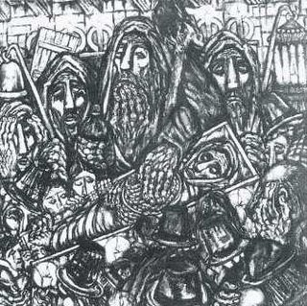
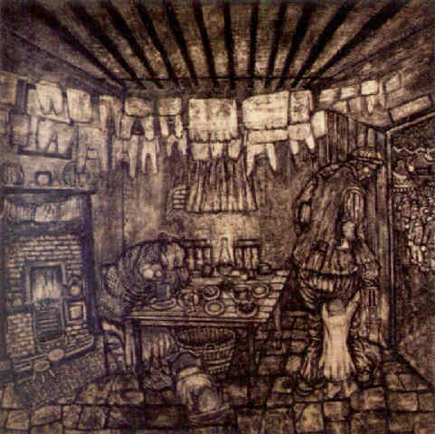
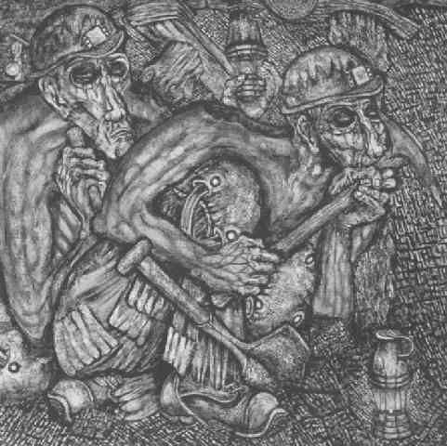
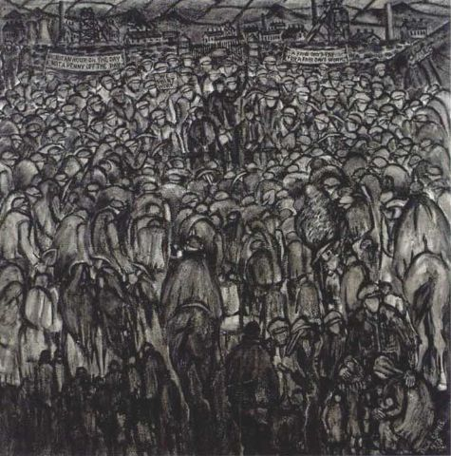
Nicholas Evans Pictures
Used with kind permission of Nicholas Evans
Click on the picture to enlarge
The sin eater, (no date)
Dreams very often come true, (no date)
Down the Pit, 1976
Aneurin Jones Pictures
A fair day’s pay for a fair day’s work, 1978
Previous page
Next page

Slide 5
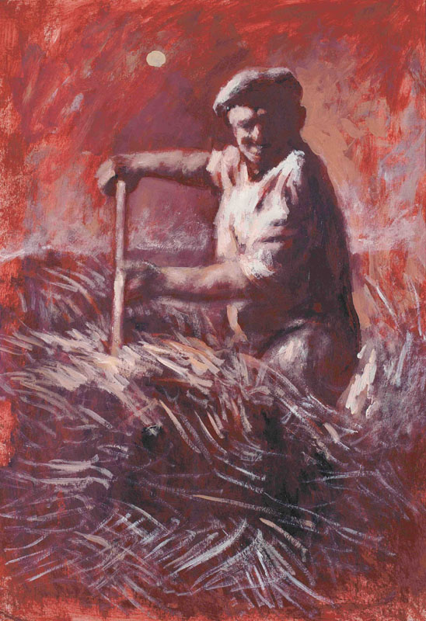
Comparing two pictures - Venn Diagram
Describe the features that are similar and dissimilar between
the two pictures below.
Features of pictures by Aneurin Jones
Features of pictures by Nicholas Evans
‘Down the Pit’ by Nicholas Evans
“Lleuad Fedi” by
Aneurin Jones
Features of both pictures
Previous page

Slide 6
Cwm Wysg
Back to Aneurin Jones Page
Next page

Slide 7
Tug o’ war
Back to Aneurin Jones Page
Next page

Slide 8
Cymeriadau
Back to Aneurin Jones Page
Next page

Slide 9
Sir Gar
Back to Aneurin Jones Page
Next page

Slide 10
Lleuad Fedi
Back to Aneurin Jones Page
Next page

Slide 11
The Sin Eater, (no date)
Back to Nicholas Evans Page
Next page

Slide 12
A fair day’s pay for a fair day’s work, 1978
Back to Nicholas Evans Page
Next page

Slide 13
Down the Pit, 1976
Back to Nicholas Evans Page
Next page

Slide 14
Dreams very often come true, (undated)
Back to Nicholas Evans Page

